Slide 1

19CSE 202 DBMS FINAL REVIEW LEAVE MANAGEMENT SYSYTEM
GROUP : 6
TEAM MEMBERS:
S.NO | ROLL NUMBER | NAME
1 | CB.EN.U4CSE19131 | MEENAKSSHI S
2 | CB.EN.U4CSE19142 | S R HARINYA DEVI
3 | CB.EN.U4CSE19144 | SANGEERTHANA B
4 | CB.EN.U4CSE19118 | IMMANI SRI KAVYA

Slide 2
Problem definition
Leave Management System :
Ranging from the small companies in the town to the large organizations and multinational companies, an online leave management system has become a necessity for these associations to have a smooth and flexible workplace environment. Though the organizations would want their employees to be at the workplace with complete involvement, there might be times when the employees would have to take day-offs.
The aim of this project is to design and develop a database management system for an organization to maintain records of the leaves taken by its employees.

Slide 3
Problem definition
Leave Management System :
This database also maintains records of different leaves that the employees can avail:
Earned/Privilege leave
Casual leave
Medical leave
Half-pay leave
Maternity leave
Marriage leave
Vacation leave
Sabbatical leave
Lockdown leave
Accordingly, the payroll system will also be related to this leave management system in order to maintain the salary records of the employees.

Slide 4
Motivation
A lot of organizations today work day and night to improve the efficiency of the world in progressing. In such a case, no organization can compromise on the halt in the work flow. They would want their employees to give in their full cooperation and concentration in making the organization the best. But at unavoidable circumstances, the employees would have to take day-offs which would bring in a pause in the work flow. To efficiently handle the leaves taken by the employees and to arrange for the compensation during the employees’ absence, we bring in this leave management system where most of the work gets done automatically and thus the paper work gets reduced. The motivation behind this project is to provide an efficient leave management system for organizations which would reduce the tedious paper work and make the whole system well-organized.

Slide 5
Mission
Our mission is to promote online leave management system where the tedious paper work is reduced and the allotment of leaves for the employees are done very efficiently. This kind of an online system helps in organizing the leave records in a systematic manner and hence the work flow is done smoothly.
Role and responsibilities
This online leave management system is developed to maintain a schematic database where the employees leave records are well-maintained. Such a system is imposed to maintain a better work environment and nurture the needs of the employees as well as the organization.

Slide 6
Benefits
Reduces paper work
Reduce manual interventions
Faster communication between the employee and the higher officials.
Legal proof and records
Well defined reports with high data security
Increases the efficiency
This kind of a system is:
-technically feasible
-economically feasible
-operationally feasible

Slide 7
Modules and functionalities
Customizable dashboard and a dynamic interface
Two different views: Employee and Administrator
Employee : modules and functionalities
Application to avail a leave
Modify the leave information
Change the duration of leave
View leave status
View leave balance
View payroll status (based on leave history)
Update his/her profile
View leave history
2) Administrator: modules and functionalities
Configure the list of holidays and leaves
Accept/reject a leave
Modify payroll of an employee based on leave history
Setting deadlines for leave’s duration
Accessibility to the overview of list of employees who are off on a particular day
Manage the view levels and adding constraints on accessibility to information (to maintain security for information that is shared only between employee and administrators)

Slide 8
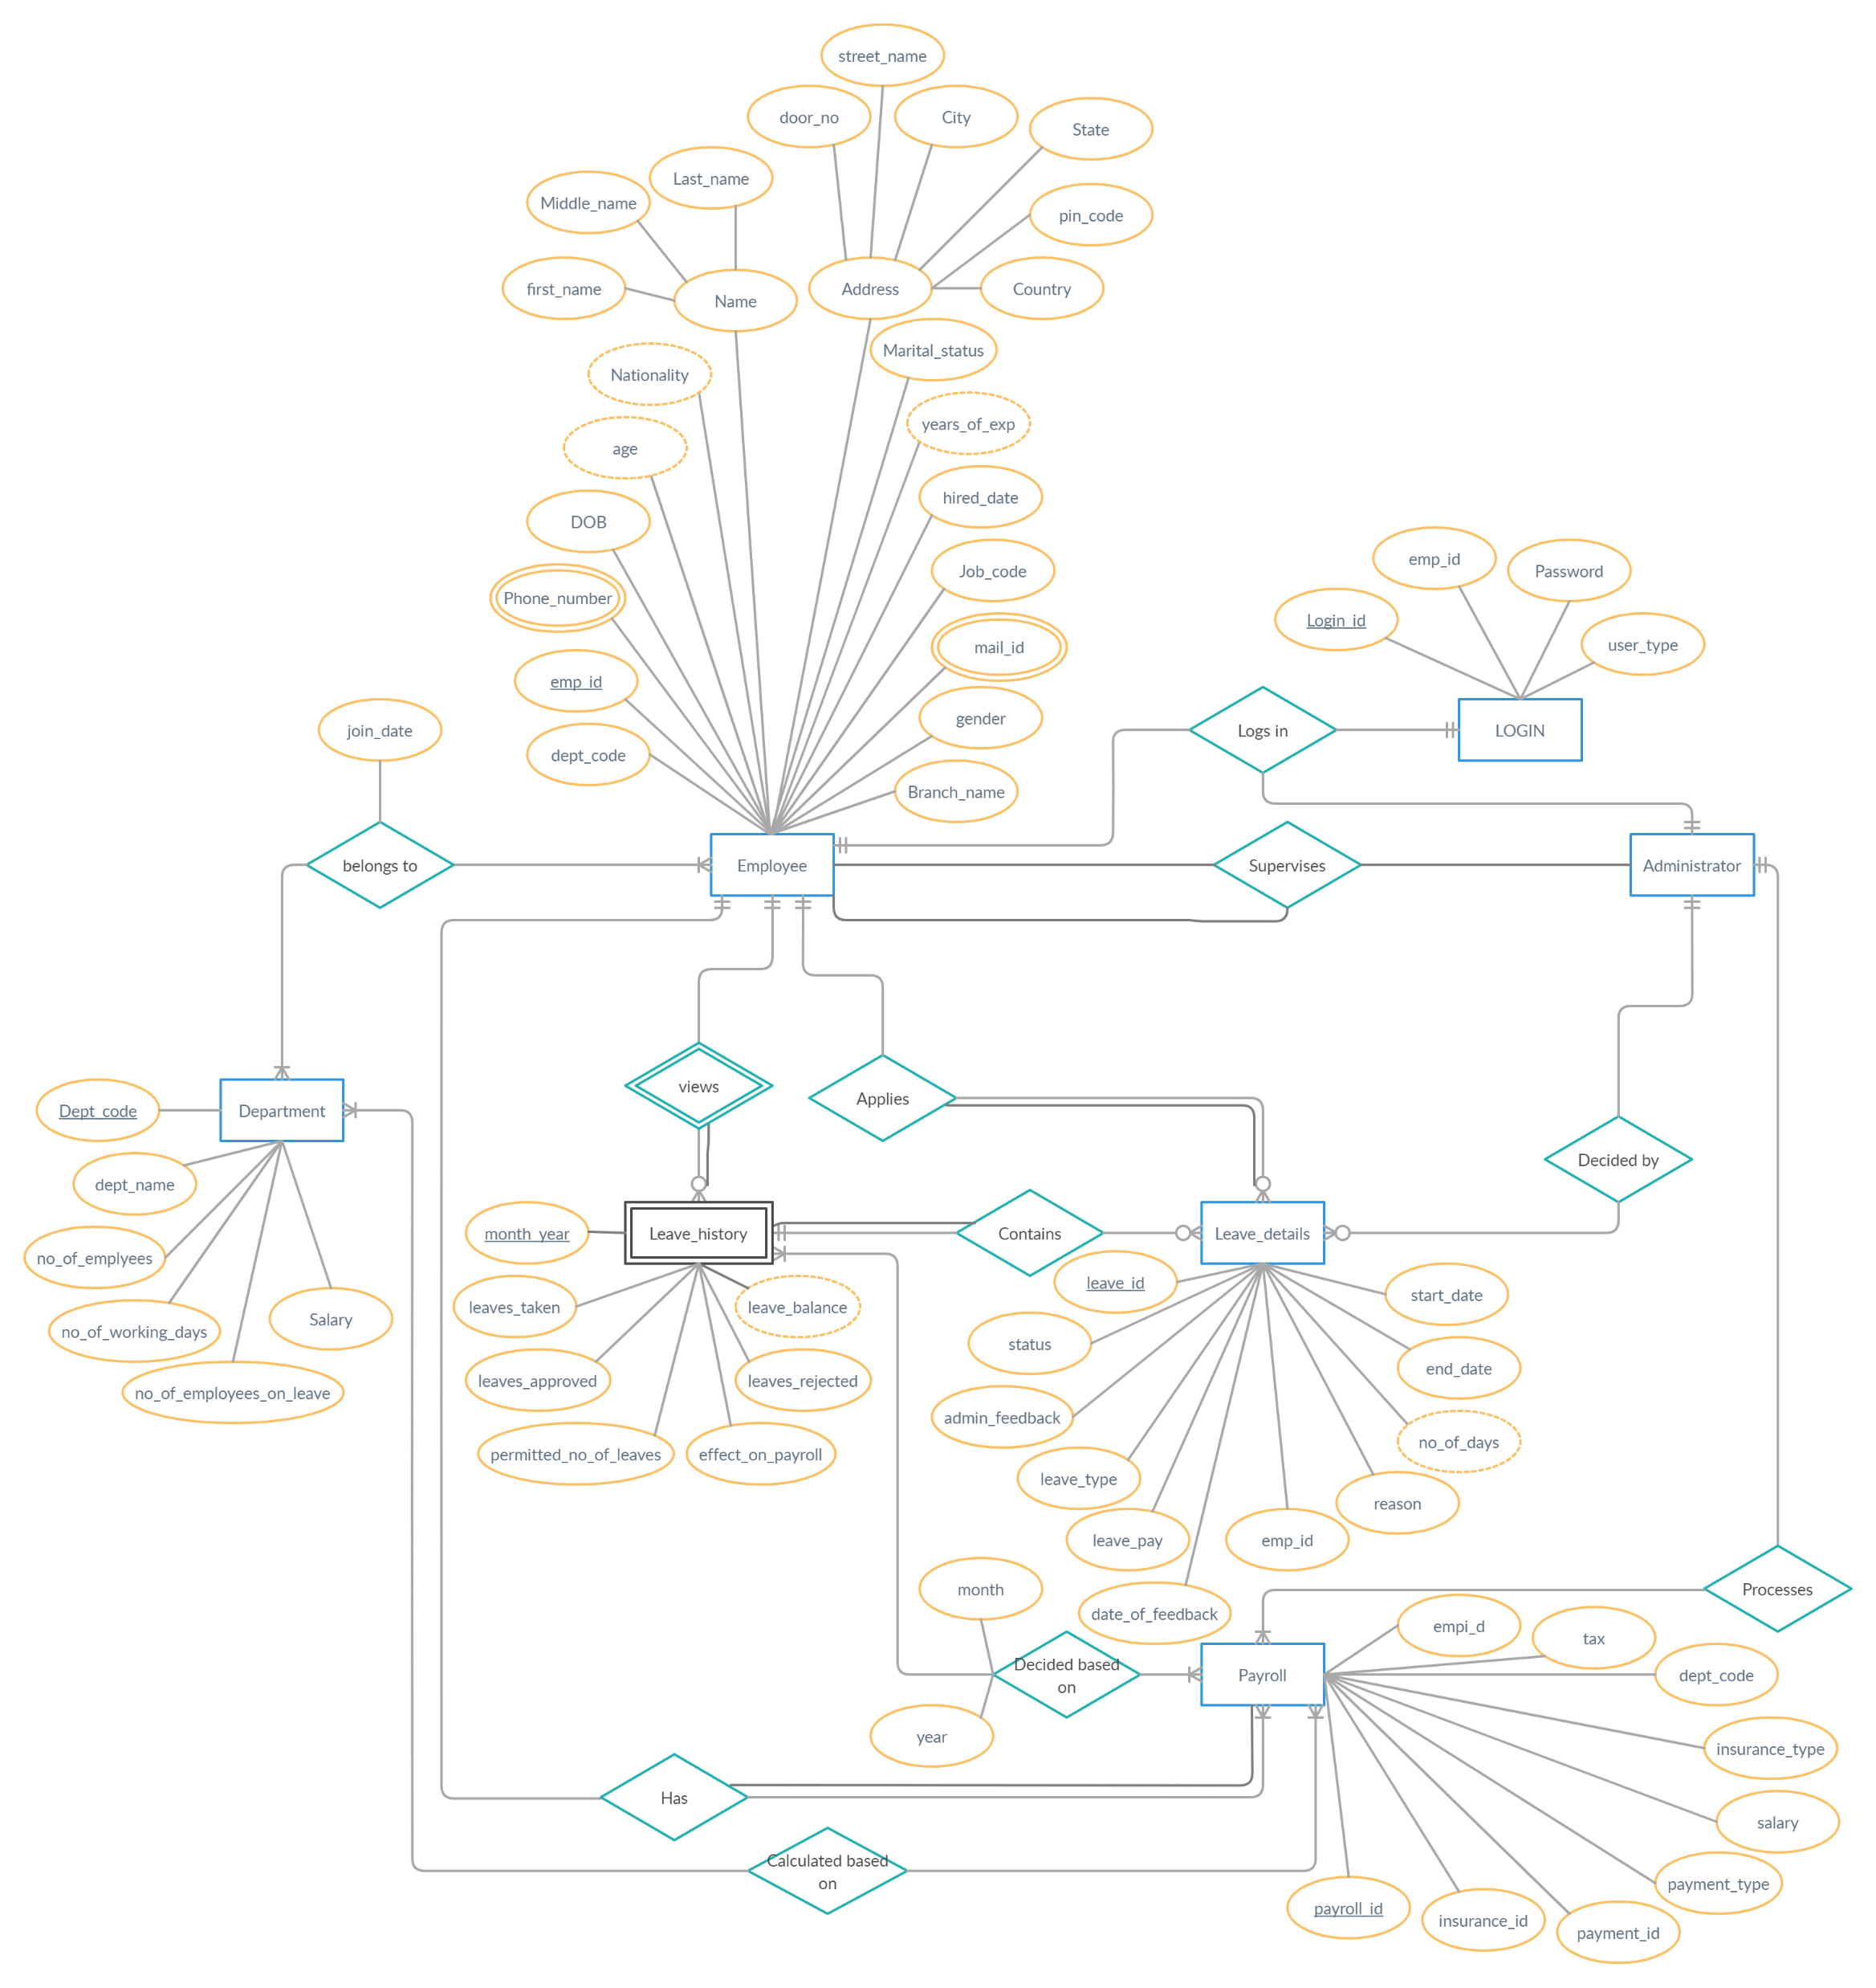
ER DIAGRAM :

Slide 9
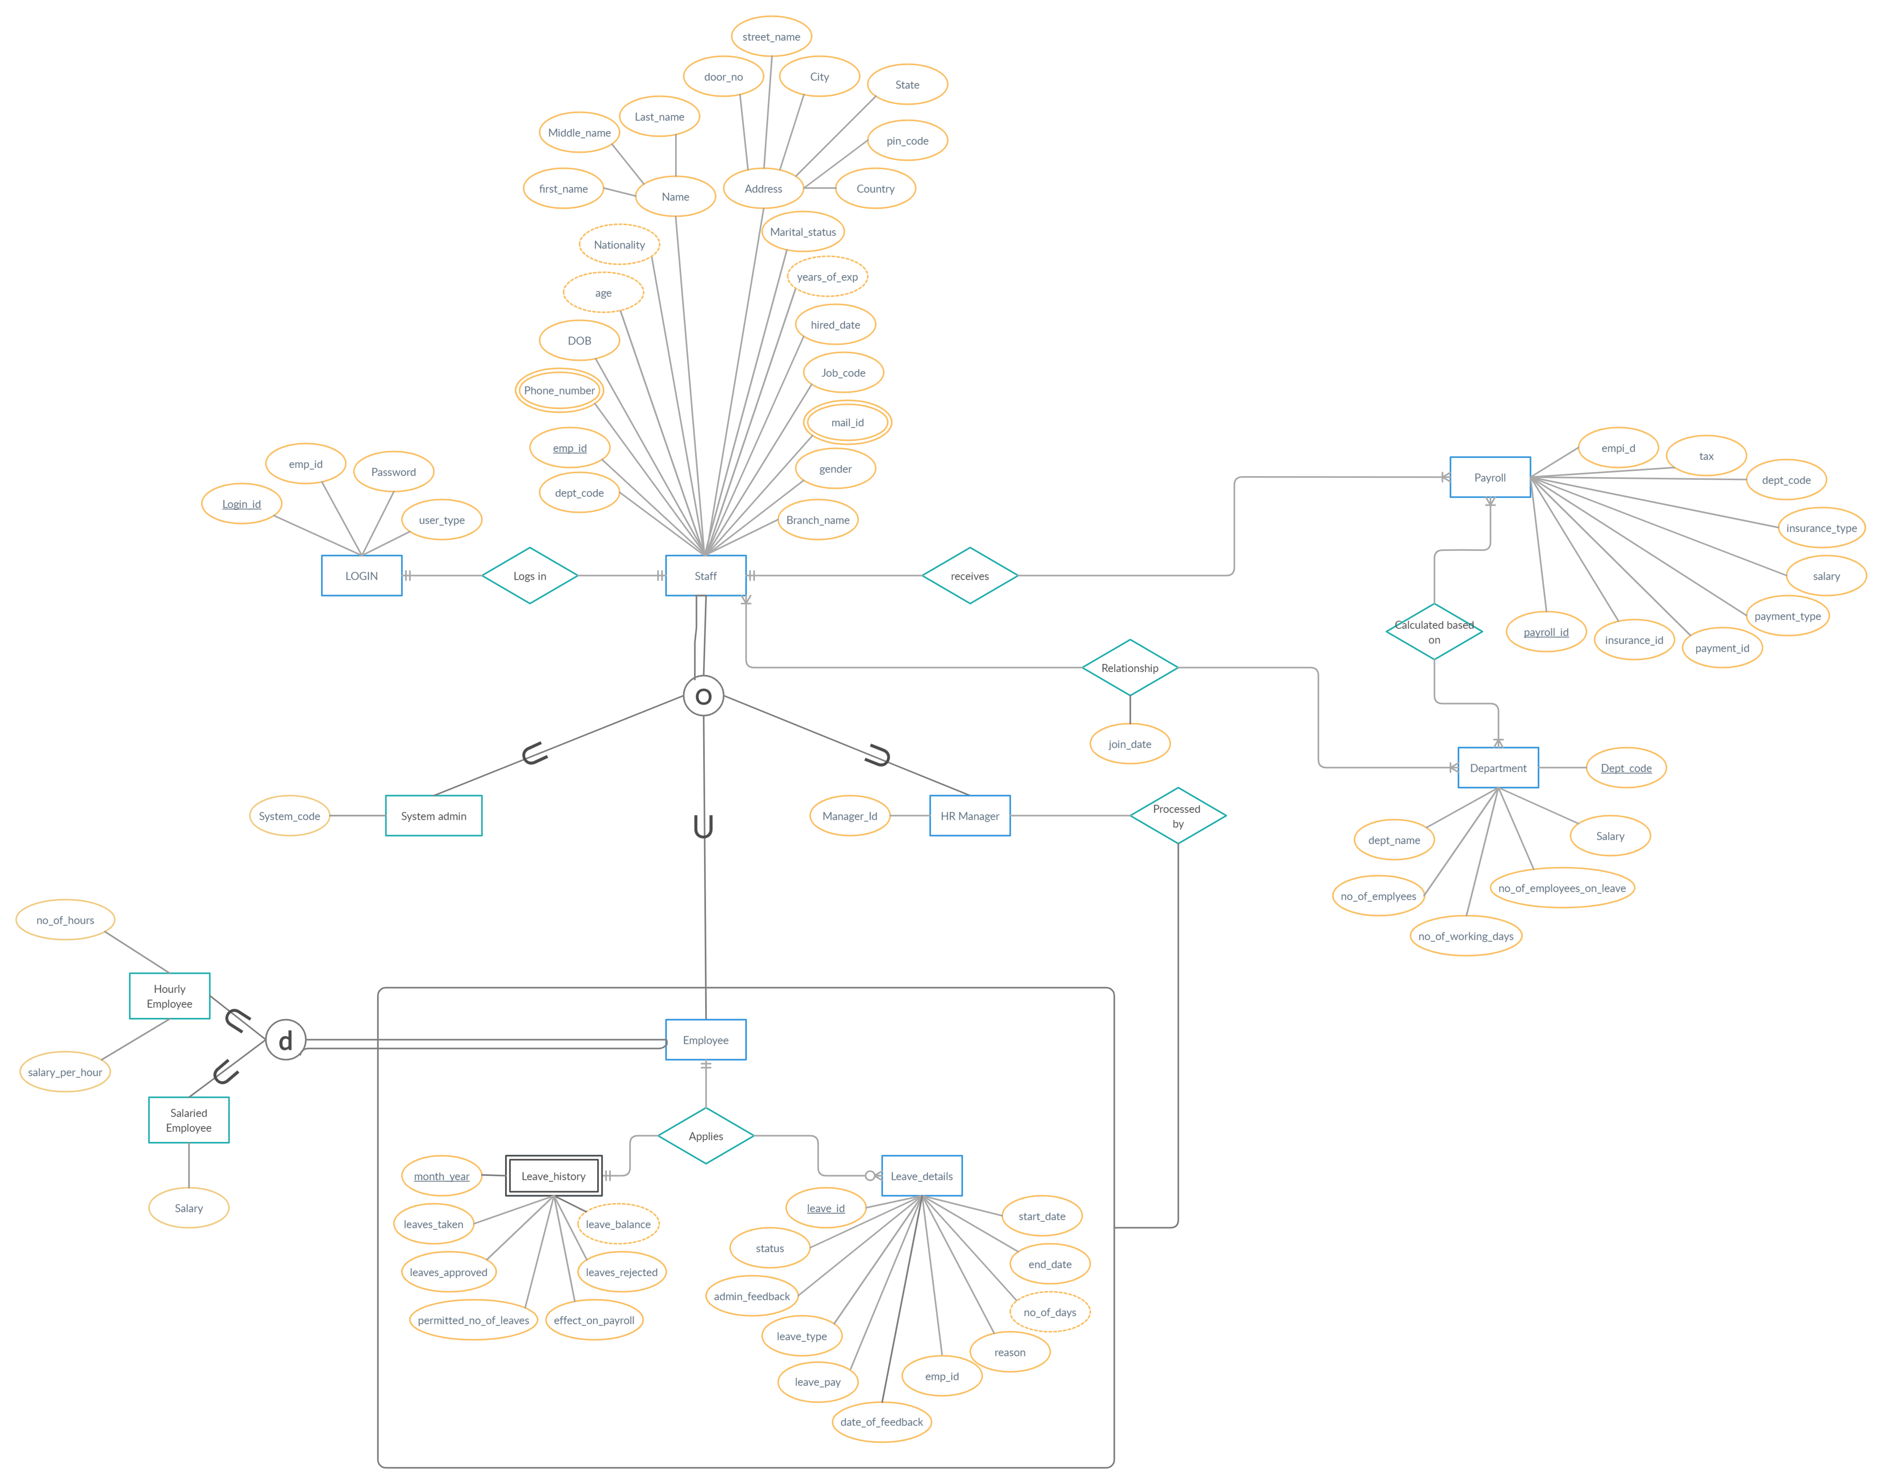
EER DIAGRAM :

Slide 10
Normalized tables
Emp_id | Dept_code | Hire_date | Join_date | Branch_name
Designation | Job_code
Pincode | city
Dept_code | Dept_name | Permitted_no_of_leaves | No_of_employees | No_of_working_days
Payroll_id | month_year | effect_on_payroll | salary | tax | payment_id | payment_type
Emp_id | Payroll_id | Salary_per_hour | No_of_hours
Emp_id | User_type | System_code | Manager_id
Login_id | User_type | password
Emp_id | Leave_id | Month_year | Mail_id | Phone_number
Dept_code | Month_year | no_of_employees_on_leaves

Slide 11
Normalized tables
emp_id | phone_number
emp_id | mail_id
City | state
Payroll_id | Dept_code | Insurance_id | Insurance_type
Leave_type_code | Leave_type | Leave_pay
Emp_id | First_name | Middle_name | Last_name | Gender | Job_code | Dob | Door_no | Street_name | Marital_status | No_of_days_worked | Dept_code | pincode | Payroll_id | Dept_name | designation | Login_id
Emp_id | month_year | leaves_approved | leaves_rejected | leaves_taken
Leave_id | leave_type | start_date | end_date | reason | status | admin_feedback | date_of_feedback

Slide 12

Software/Tools Used
FRONT END : JAVA
BACK END : MYSQL
TO ESTABLISH THE CONNECTION : JDBC
JDBC :JDBC stands for Java Database Connectivity. JDBC is a Java API to connect and execute the query with the database. It is a part of JavaSE (Java Standard Edition). JDBC API uses JDBC drivers to connect with the database.
We can use JDBC API to handle database using Java program and can perform the following activities:
Connect to the database
Execute queries and update statements to the database
Retrieve the result received from the database.

Slide 13
Packages imported from Java in our project :
1) java.lang: Contains language support classes like the classes which defines primitive data types, math operations etc. (This package is automatically imported.)
2) java.io: Contains classed for supporting input / output operations.
3) java.util: Contains utility classes which implement data structures like Linked List, Dictionary and support ; for Date / Time operations.
4) java.awt: Contain classes for implementing the components for graphical user interfaces (like button , ;menus etc). Java AWT (Abstract Window Toolkit) is an API to develop GUI or window-based applications in java. Eg:TextField, Label, TextArea, RadioButton, CheckBox, Choice, List etc.
5) java.sql : We have relational databases, from which at many times we need to access the data. For various data processing related matters from RDDBMS we have java.sql package. This package include classes and interface to perform almost all JDBC operation such as creating and executing SQL Queries.
6) javax.sql : This package is also known as JDBC extension API. It provides classes and interface to access server-side data.
7) javax.swing : Java Swing is a part of Java Foundation Classes (JFC) that is used to create window-based applications. It is built on the top of AWT (Abstract Windowing Toolkit) API and entirely written in java. Unlike AWT, Java Swing provides platform-independent and lightweight components. Eg: JButton, JTextField, JTextArea, JRadioButton, JCheckbox, JMenu, JColorChooser etc.

Slide 14
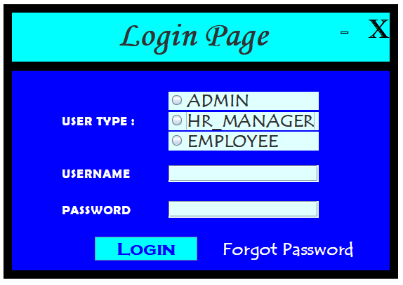
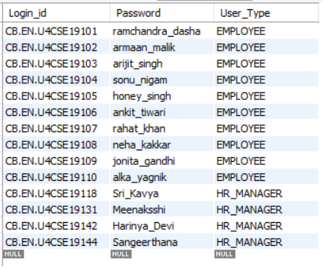
UI Screenshots
First row details entered as login credentials
Main
Page

Slide 15
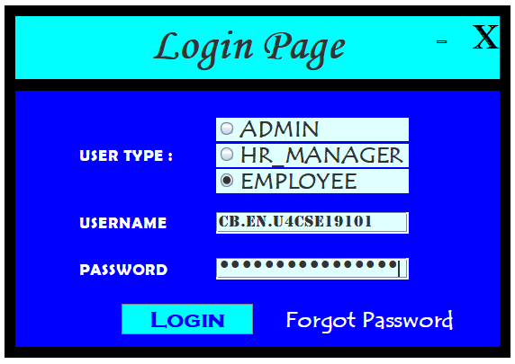
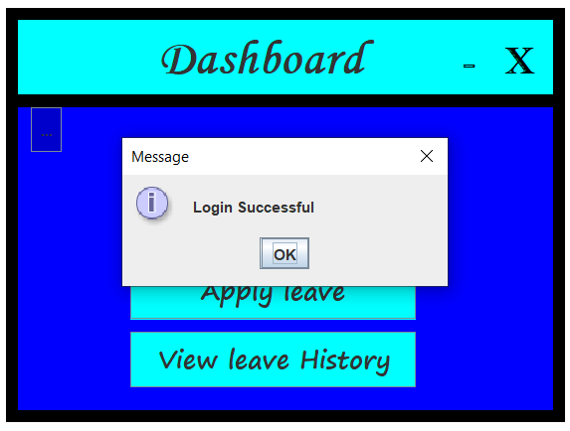
UI Screenshots
Login is clicked
User type, Username and Password are verified (compared with the DB)

Slide 16
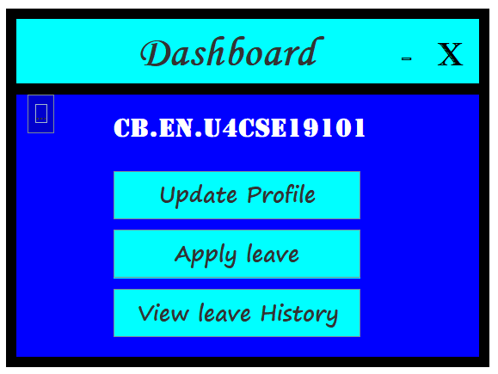
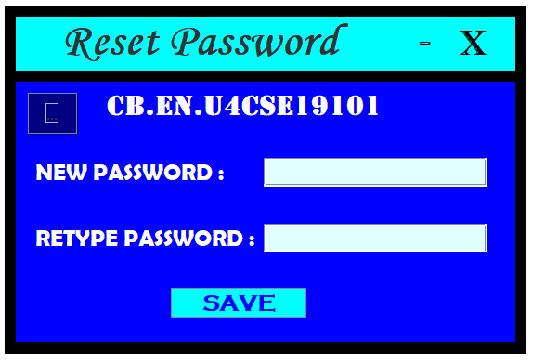
UI Screenshots
UPDATE PROFILE IS CLICKED
THE USER CAN RESET HIS/HER PASSWORD
Username is displayed in the Dashboard

Slide 17
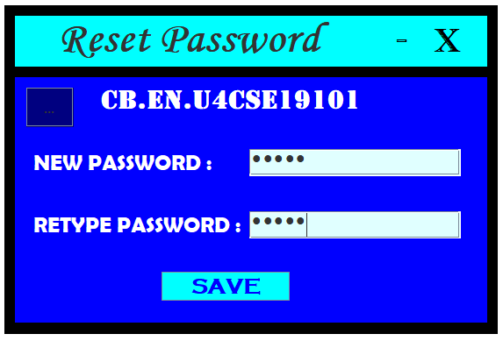
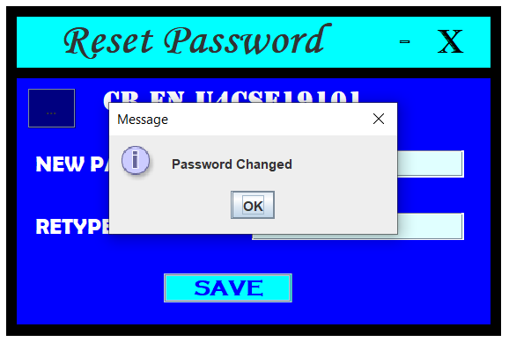
UI Screenshots
Password entered is “hello”
Since New Password and Retype password matches, Password is updated in the DB

Slide 18
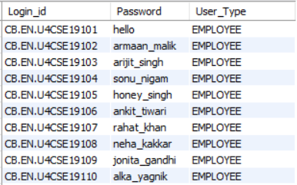
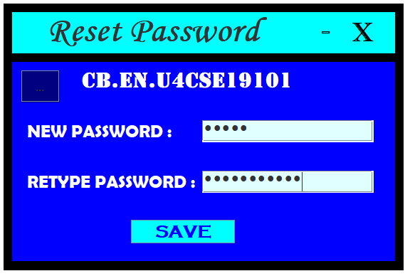
UI Screenshots
Password updated successfully
IF BOTH THE PASSWORDS DOESN’T MATCH

Slide 19

UI Screenshots
Appropriate message is displayed
PASSWORD IS NOT UPDATED IN THE DB!!!

Slide 20
UI Screenshots
IF THE EMPLOYEE WANTS TO APPLY FOR A LEAVE…

Slide 21
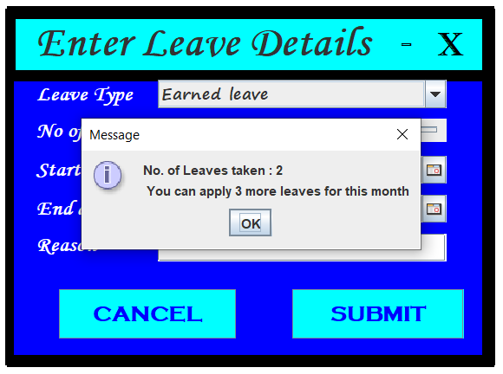
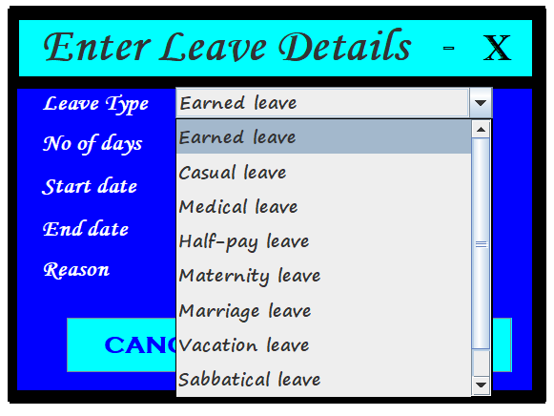
UI Screenshots
Leave balance is notified to the user
Employee can choose the type of leave from drop down menu
The user can’t apply for a leave when his leave balance = 0 for that month

Slide 22
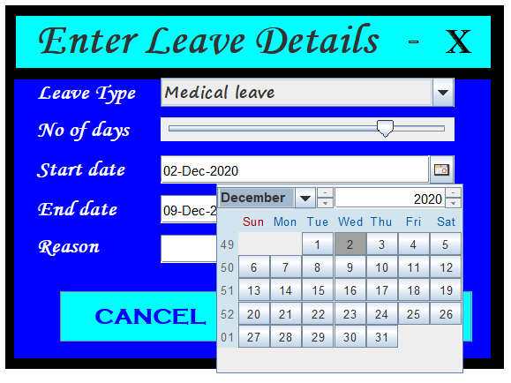
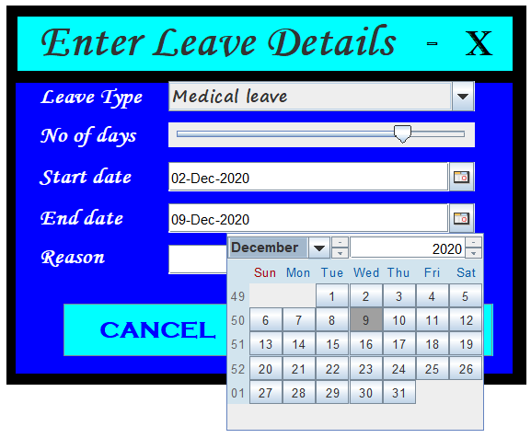
UI Screenshots
Jcalender jar file is downloaded and imported to use JdateChooser

Slide 23
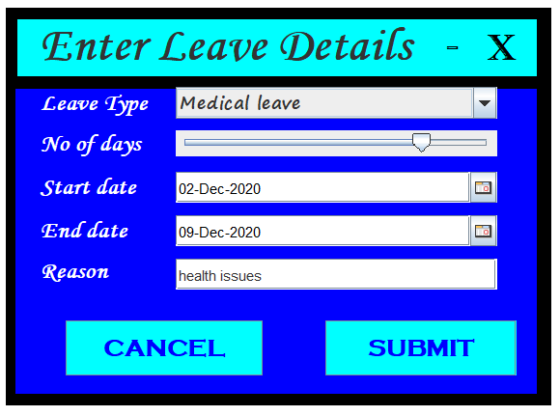
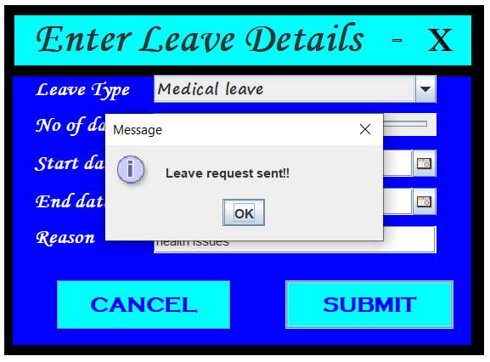
UI Screenshots
A message is sent to the HR Manager
Slider is used to input the number of days.
Min : 1
Max : 10

Slide 24
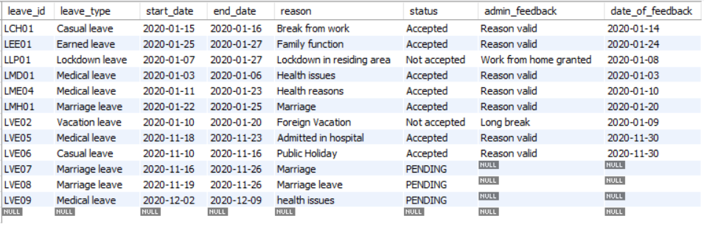
UI Screenshots
Leave details updated in the DataBase in MYSQL
Status is set to “PENDING” by default until the HR Manager approves/rejects the leave

Slide 25
UI Screenshots
IF THE EMPLOYEE WANTS TO VIEW HIS/HER LEAVE HISTORY..

Slide 26
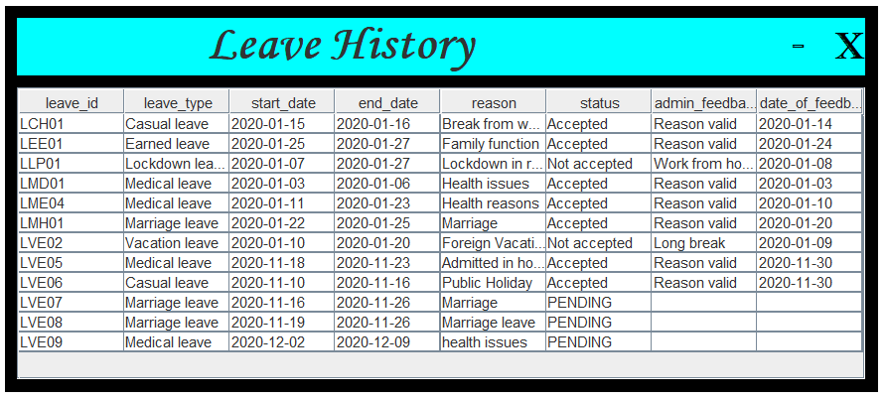
UI Screenshots
ALL DETAILS ARE RETRIEVED FROM THE DATABASE AND DISPLAYED TO THE EMPLOYEE

Slide 27
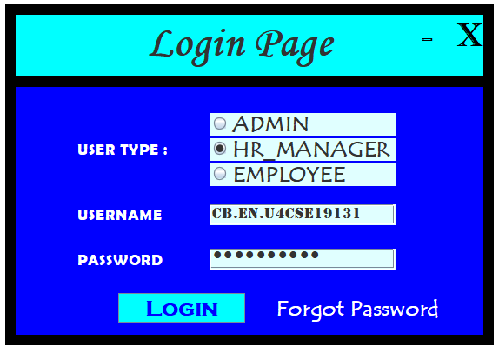
UI Screenshots
These details are entered as login credentials
WHEN THE HR MANAGER LOGS IN INTO HIS/HER ACCOUNT

Slide 28
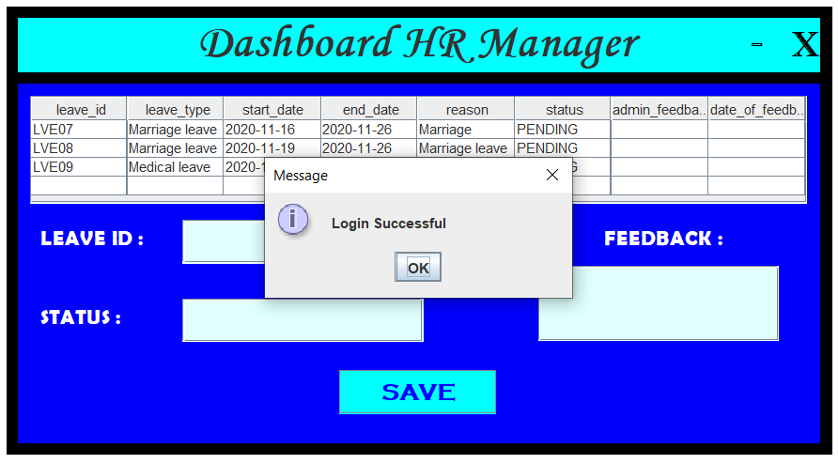
UI Screenshots
User type, Username and Password are verified (compared with the DB)

Slide 29
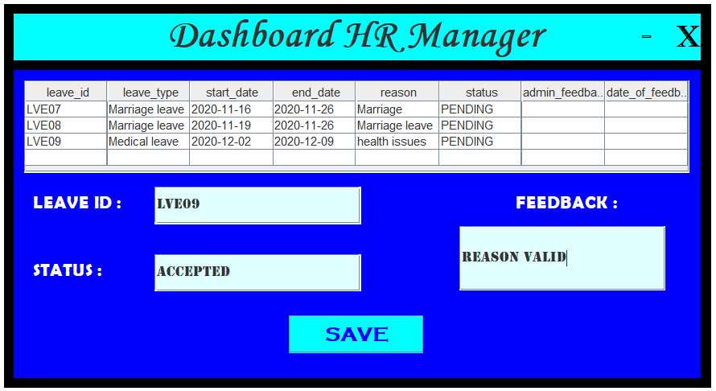
UI Screenshots
HR manager enters the corresponding leave id and updates the status

Slide 30
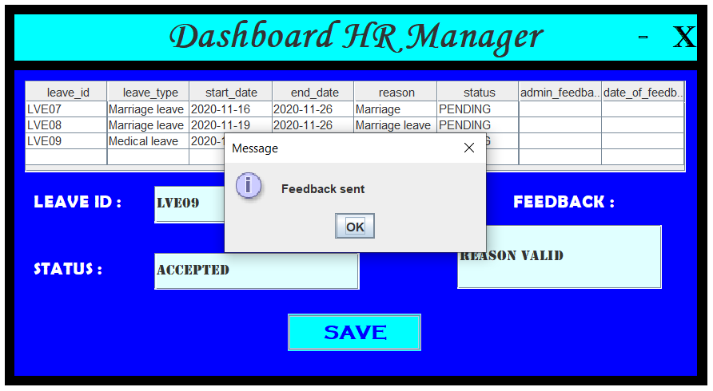
UI Screenshots
Details will be updated in the DB

Slide 31
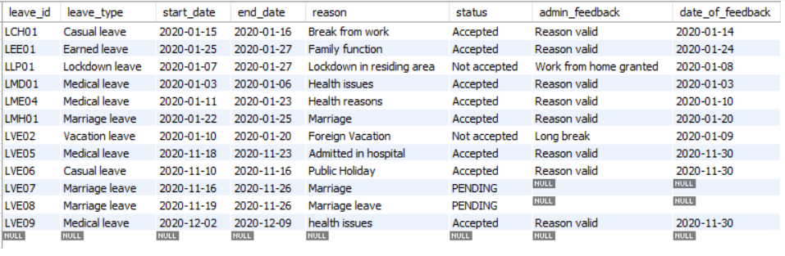
UI Screenshots
Leave details updated in the DataBase in MYSQL
Status is set to “ACCEPTED” and the date_of_feedback will be set automatically to the current date

Slide 32
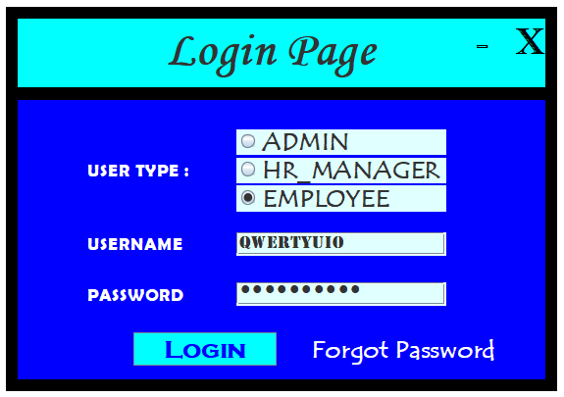
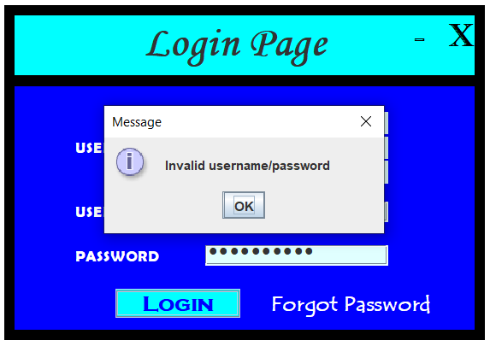
UI Screenshots
If invalid credentials are entered :
Appropriate message is displayed

Slide 33
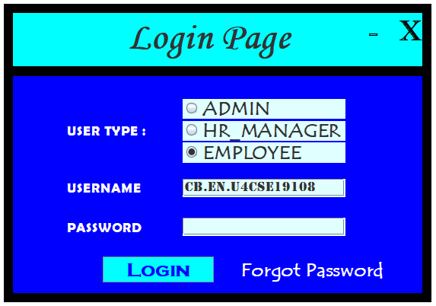
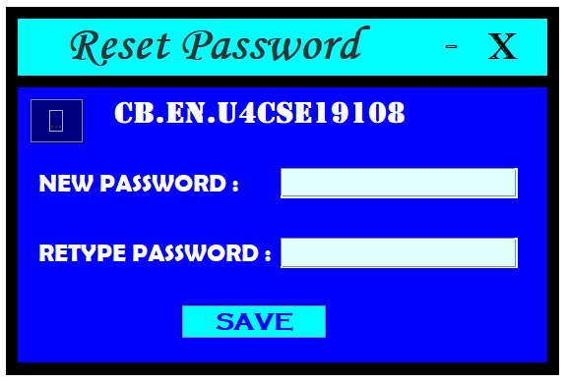
UI Screenshots
IF THE USER FORGETS HIS/HER PASSWORD …
THE USER CAN RESET HIS/HER PASSWORD

Slide 34


UI Screenshots
Password entered is “HELLO”
Since New Password and Retype password matches, Password is updated in the DB

Slide 35
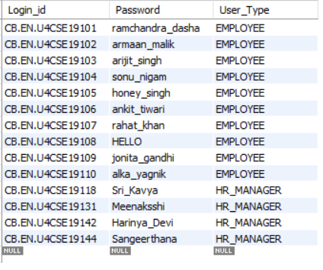
UI Screenshots
Password is updated successfully

Slide 36
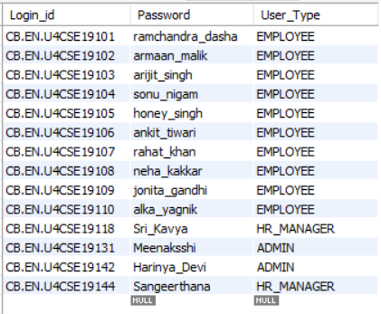
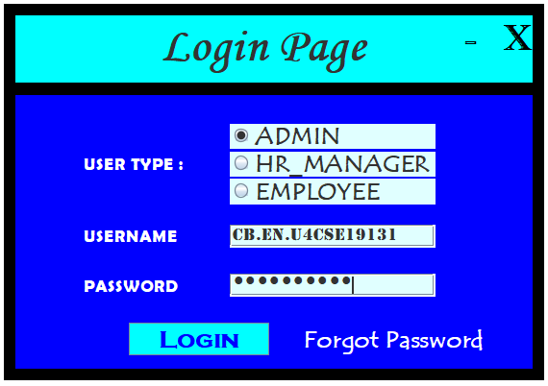
UI Screenshots
SYSYTEM ADMIN LOGS IN INTO HIS/HER ACCOUNT
These details are entered as login credentials

Slide 37
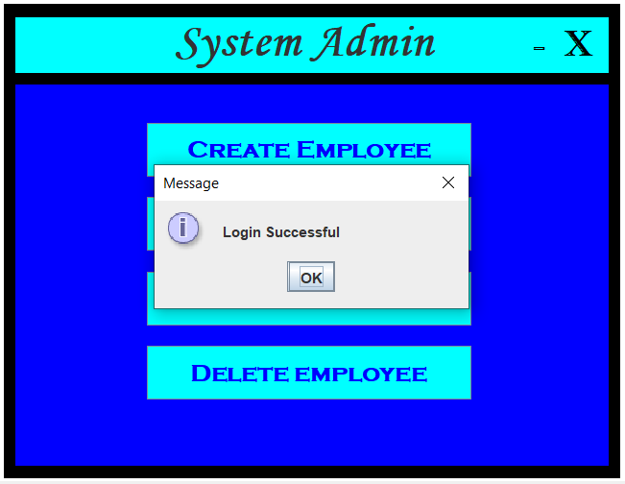
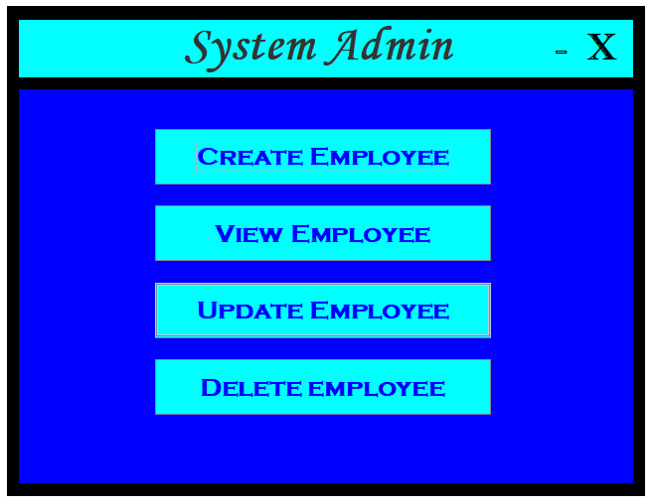
UI Screenshots
User type, Username and Password are verified (compared with the DB)

Slide 38
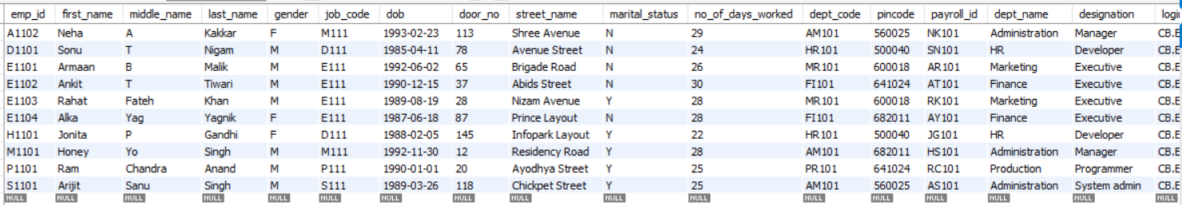
UI Screenshots
10 ROWS!!
Before entering details of new employee

Slide 39
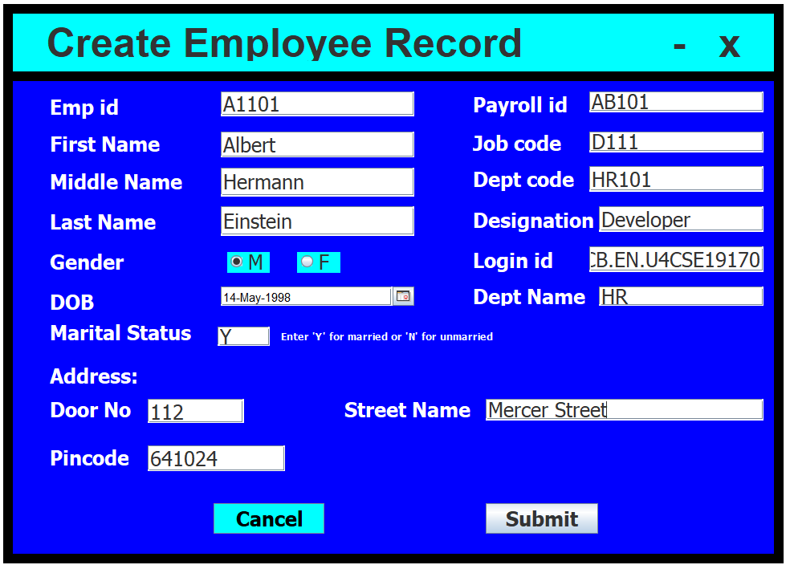
UI Screenshots

Slide 40
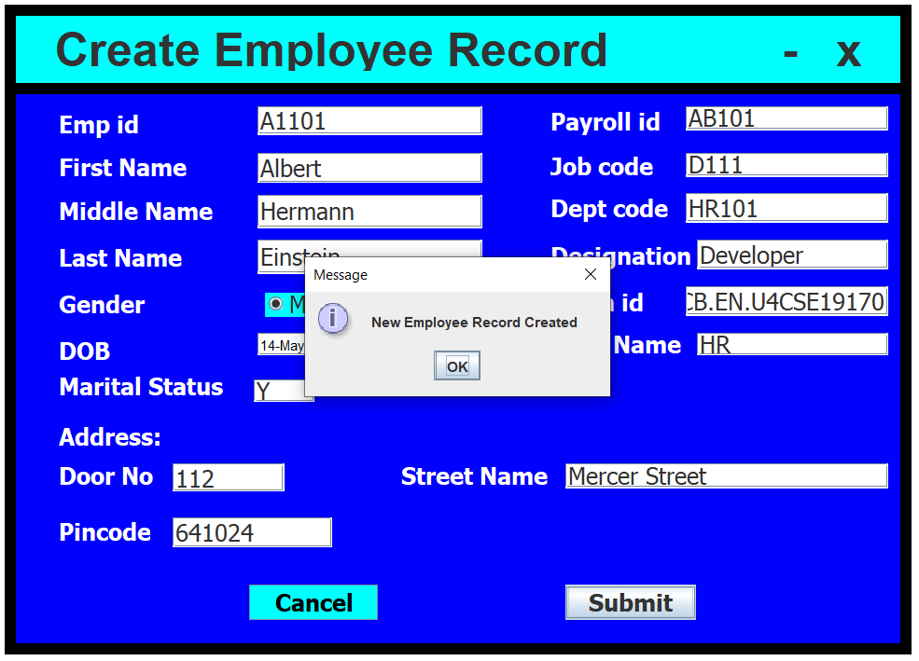
UI Screenshots

Slide 41
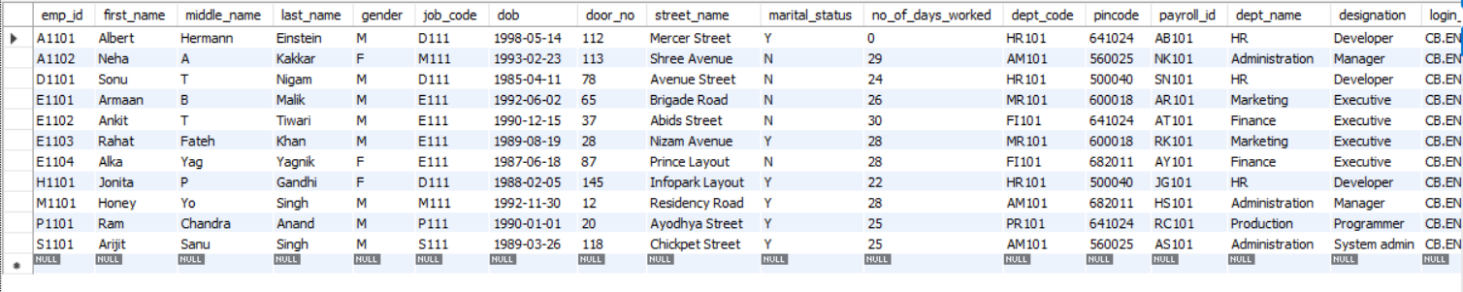
UI Screenshots
Details of new employee is inserted as a separate row in the DB
11 ROWS!!

Slide 42
UI Screenshots
IF THE ADMIN WANTS TO DELETE THE DETAILS OF AN EMPLOYEE FROM THE DB

Slide 43
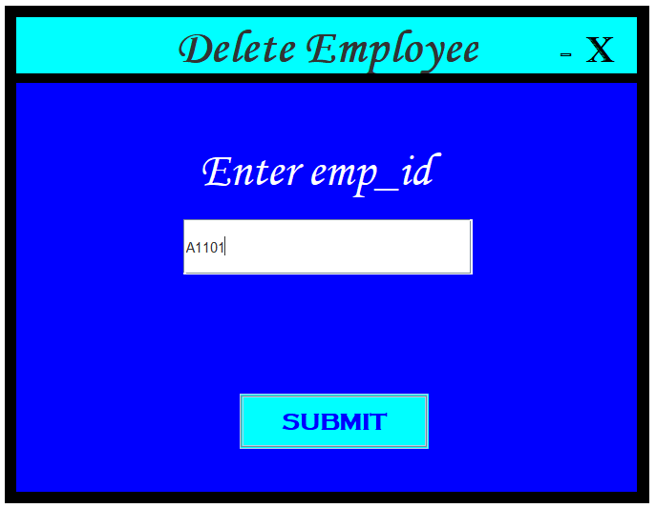
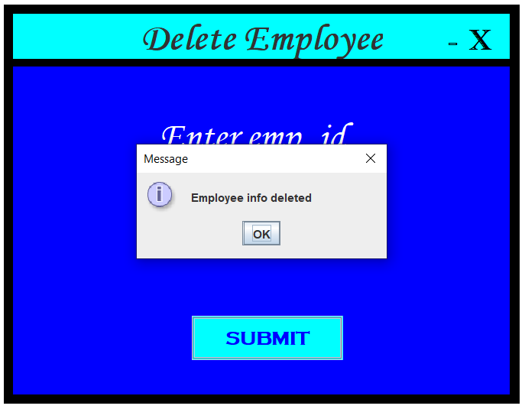
UI Screenshots

Slide 44
UI Screenshots
Details of employee is DELETED from the DB
10 ROWS!!

Slide 45
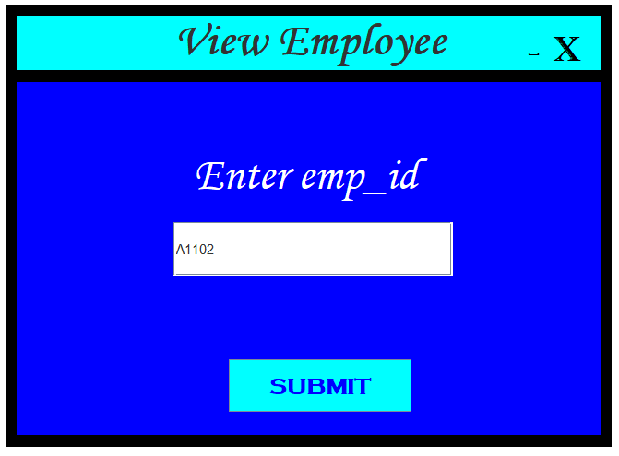
UI Screenshots

Slide 46
UI Screenshots
Details of employee is retrieved from the DB and displayed

Slide 47
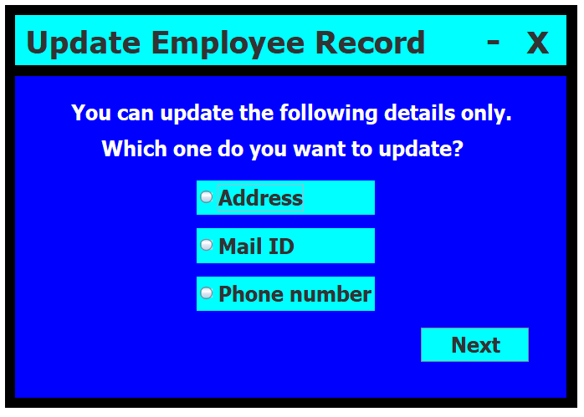
UI Screenshots

Slide 48
UI Screenshots
Before updating the employee’s address

Slide 49
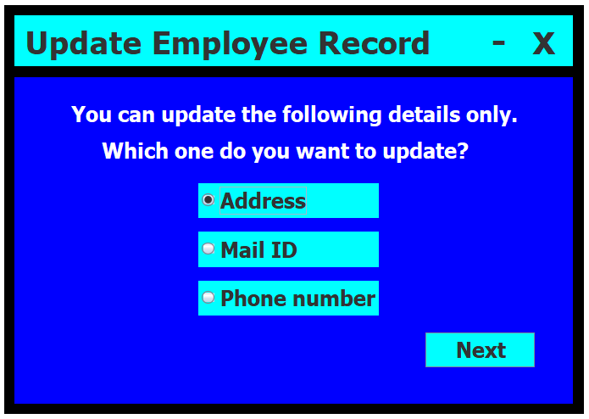
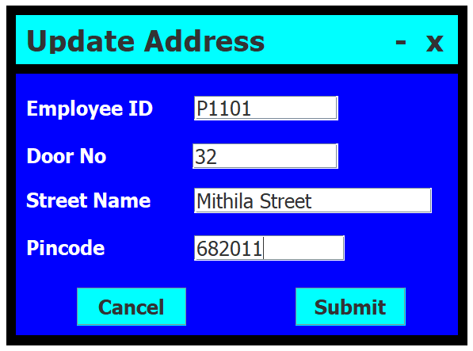
UI Screenshots

Slide 50
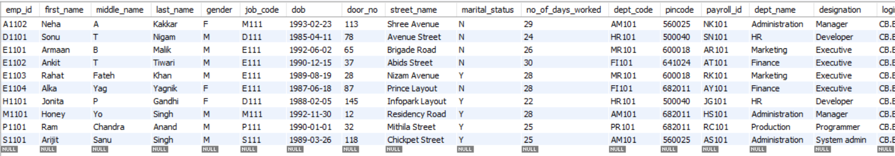
UI Screenshots
After updating the employee’s address

Slide 51
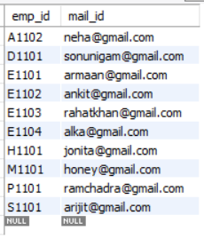

UI Screenshots
Before updating the employee’s mail id

Slide 52
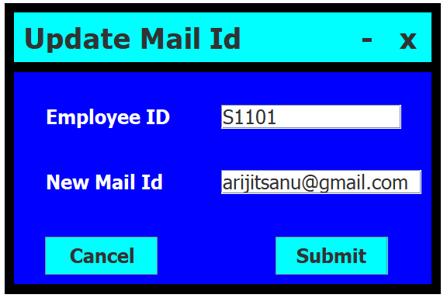
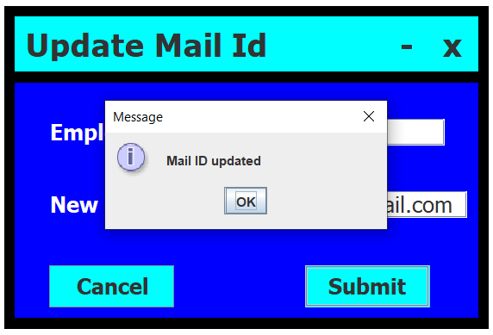
UI Screenshots

Slide 53
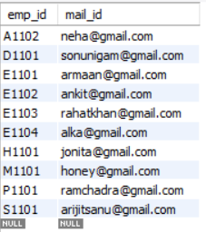
UI Screenshots
After updating the employee’s mail id

Slide 54
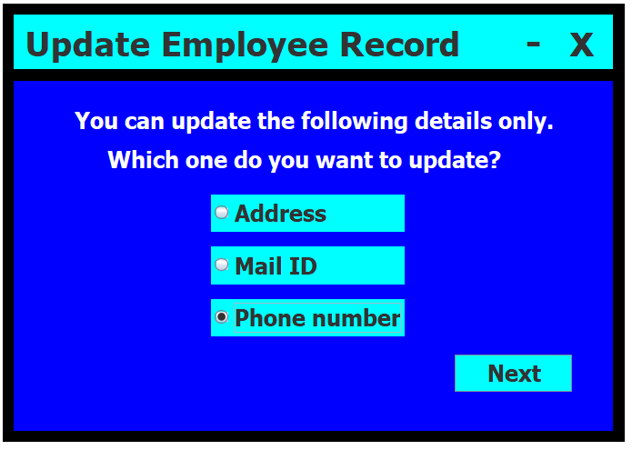

UI Screenshots
Before updating the employee’s phone number

Slide 55


UI Screenshots

Slide 56

UI Screenshots
After updating the employee’s phone number

Slide 57
Conclusion
To conclude, we have designed a system with a leave application management which can take request of the employees for leaves to be applied according to its own set of attributes filled by the user. This system is much capable of tracking the leaves of the employees by the HR Manager which would enable the organization to have clear cut records.

Slide 58
References
Establishing JDBC Connection in Java - GeeksforGeeks
https://www.geeksforgeeks.org/establishing-jdbc-connection-in-java/
JDBC - Database Connections – Tutorialspoint
https://www.tutorialspoint.com/jdbc/jdbc-db-connections.htm
Java Database Connectivity with MySQL – javatpoint
https://www.javatpoint.com/example-to-connect-to-the-mysql-database
Installing WindowBuilder Pro | The Eclipse Foundation
https://www.eclipse.org/windowbuilder/download.php
MySQL :: Download Connector/J
https://dev.mysql.com/downloads/connector/j/
JCalendar (toedter.com)
https://toedter.com/jcalendar/
MySQL :: MySQL 8.0 Reference Manual :: 2.3 Installing MySQL on Microsoft Windows
https://dev.mysql.com/doc/refman/8.0/en/windows-installation.html

Slide 59
THANK YOU

